Slide 1
3. Clon como unidad de mejoramiento genético
4. Origen de la variabilidad genética en especies clonales
5. Selección clonal
8. Relación con plantas alógamas y autógamas
9. Herramientas modernas e MGV
10. Conclusiones
MGV 2026-2: Asexuales II
2026-10-28

Slide 2
Scientific educational infographic about plant clonal propagation in banana (Musa spp.). A large healthy mother banana plant in the center generating multiple identical daughter plants through vegetative suckers. Clear visual arrows connecting the mother plant to each offspring clone. Above every plant, show identical DNA double-helix symbols glowing in blue, representing the same genotype. Include roots, rhizomes and suckers accurately represented. Professional botanical illustration style, university-level plant breeding teaching material, green and blue color palette, modern scientific infographic, clean white background, highly detailed, photorealistic botanical elements, balanced composition, educational genetics concept, high resolution, no empty space, no text, no labels, no watermark.

Slide 3
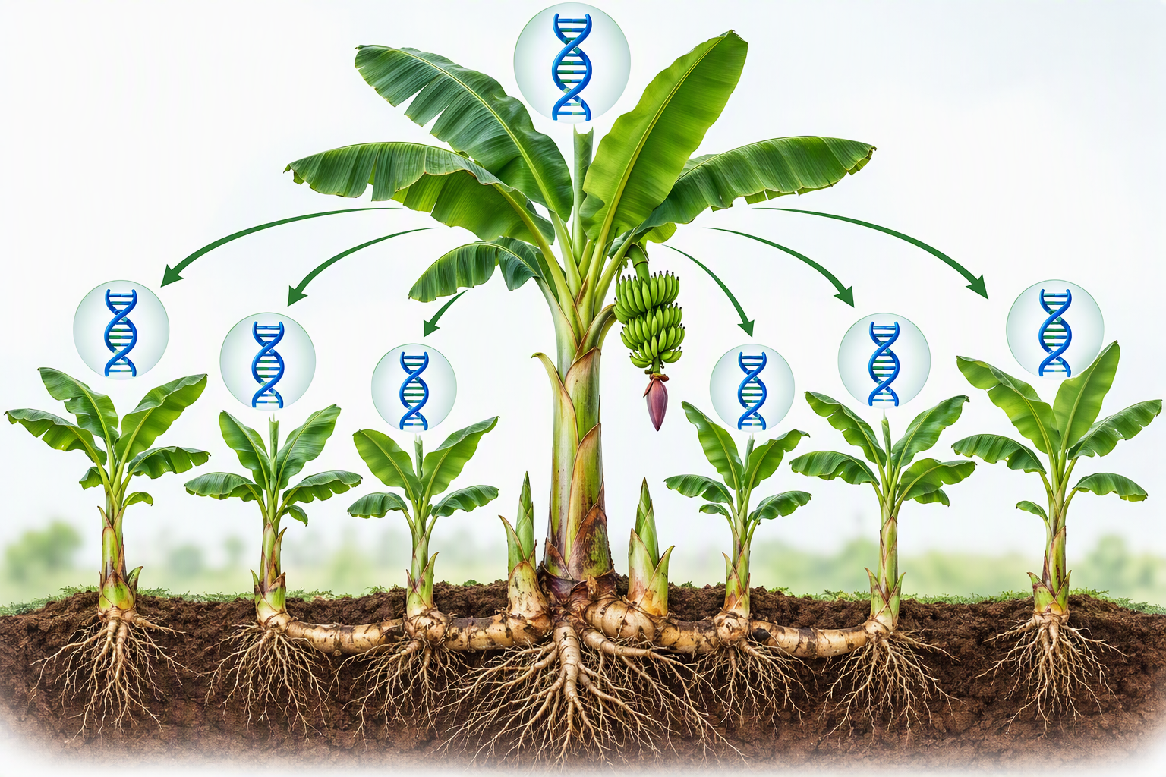

Slide 4
4: origen de la variabilidad genética
Genetic variability in clonal crops, DNA helix, hybridization, natural mutation, induced mutation, somaclonal variation, diverse banana, cassava, potato and taro plants, scientific infographic, plant breeding education, realistic, panoramic, high resolution, no text.

Slide 5
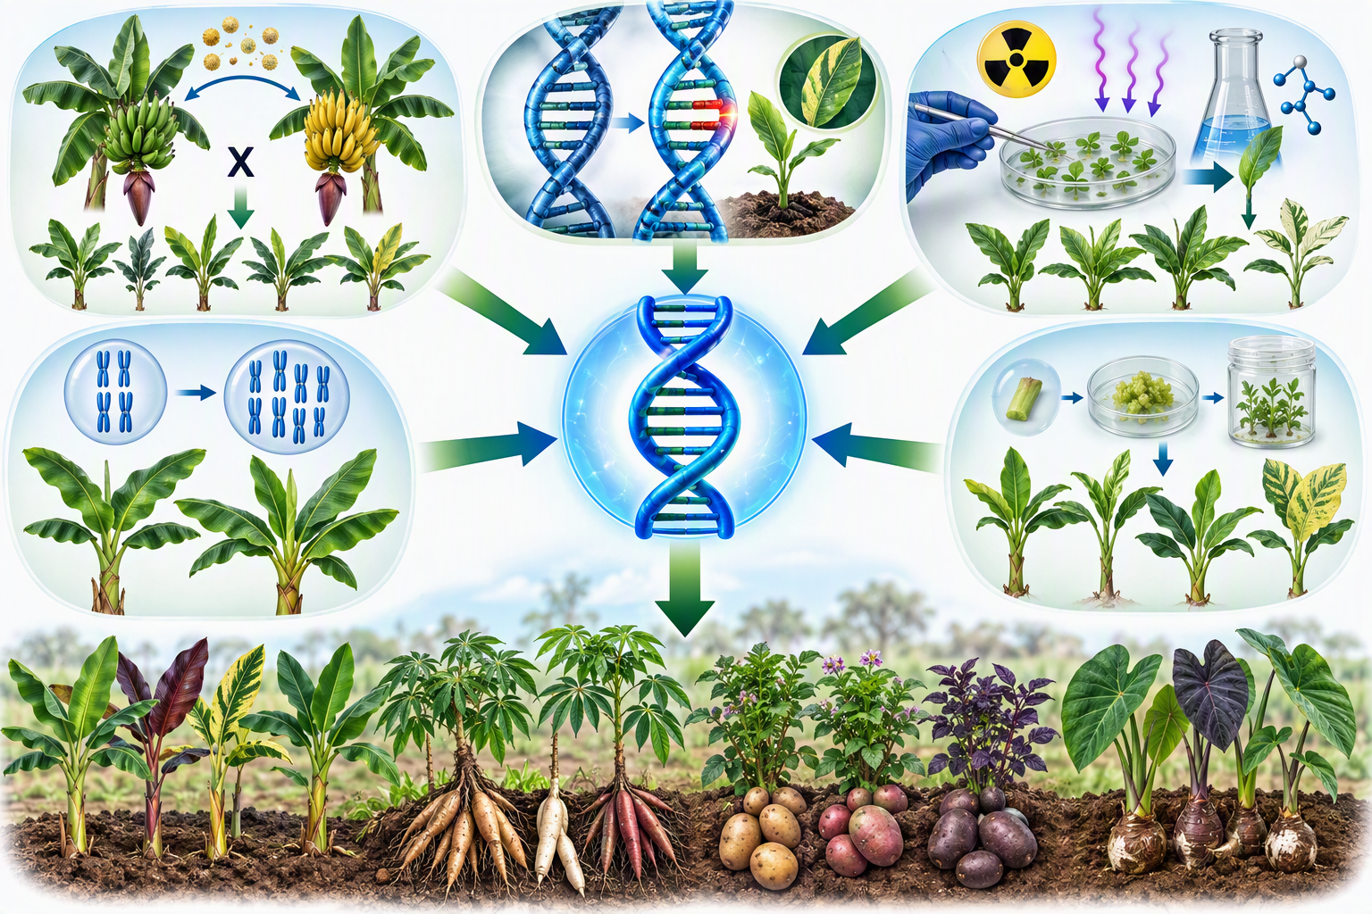

Slide 6
5: Selección clonal
Plant breeding infographic showing the clonal selection process. Diverse banana, cassava, potato and taro plants growing in replicated field trials. Several plants display different agronomic characteristics. A researcher compares performance and selects the best individual clone. Flow arrows connecting stages: variability → evaluation → selection → elite clone → multiplication. Scientific illustration, university genetics and plant breeding education, realistic field experiment, high resolution, no text except visual symbols, no empty space

Slide 7
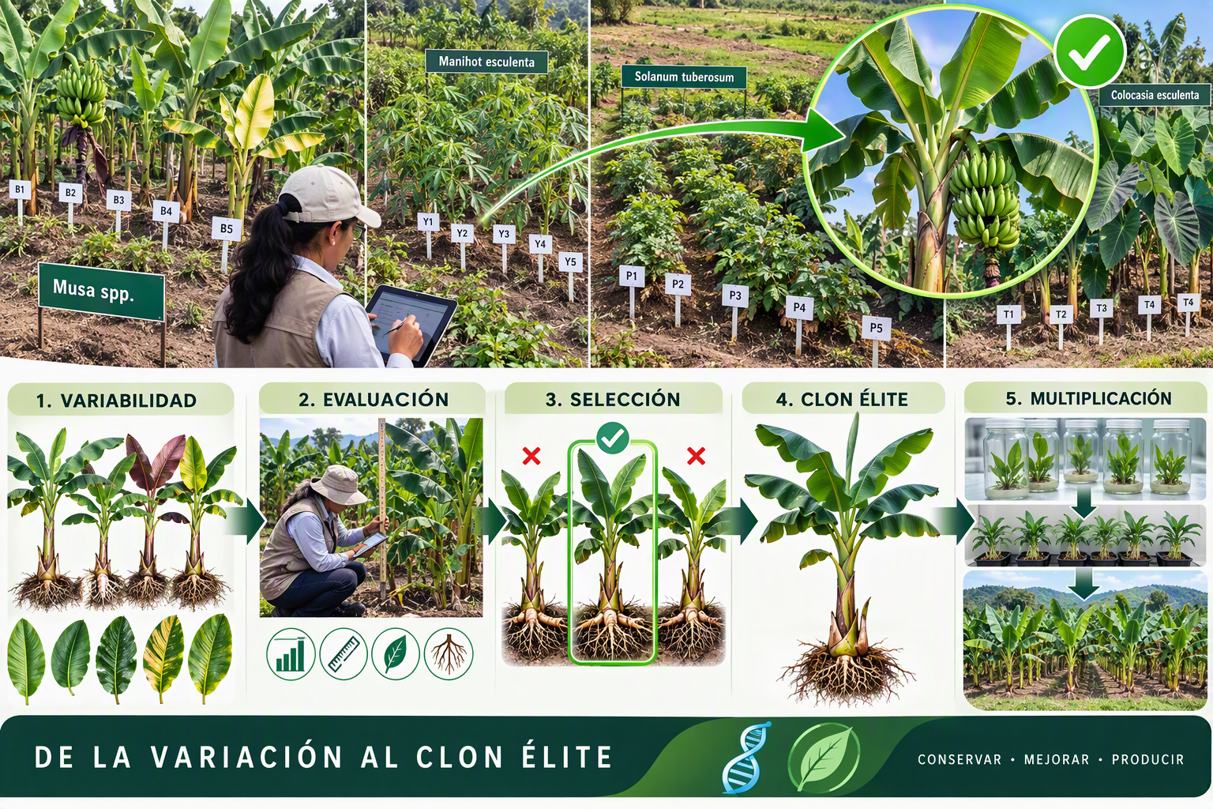

Slide 8
8: Relación con plantas alógamas y autógamas
Professional educational infographic showing the relationship between autogamous, allogamous and asexual plant breeding systems. Wheat and rice representing self-pollination and homozygosity. Maize representing cross-pollination, heterozygosity and heterosis. Banana, cassava, potato and taro representing clonal propagation and genotype conservation. Central DNA molecule connecting all systems. Arrows illustrating genetic fixation, hybrid vigor and clonal multiplication. Modern scientific illustration, realistic botanical details, genetics education, green, blue and orange palette, no text, no empty space.

Slide 9
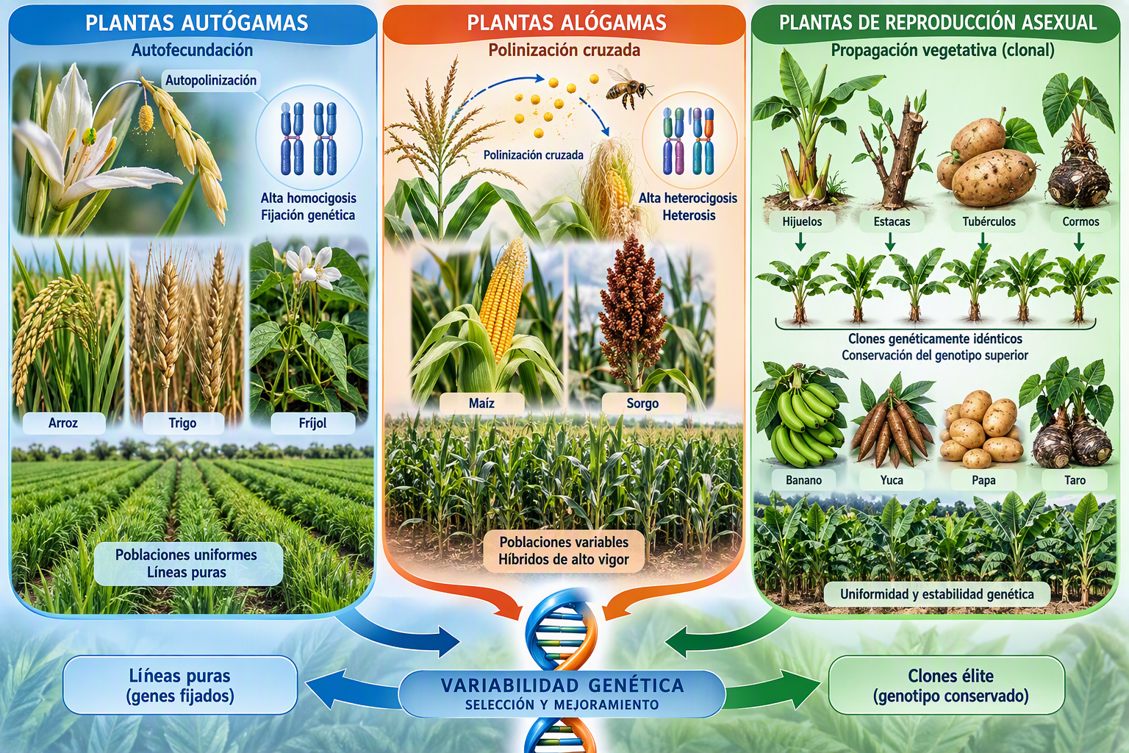

Slide 10
9: Herramientas modernas
Scientific educational infographic showing modern plant breeding technologies for vegetatively propagated crops. Central DNA molecule connected to molecular markers, PCR, genome sequencing, plant tissue culture, bioinformatics, artificial intelligence-assisted selection and drone-based phenotyping. Banana, cassava, potato and taro represented as target crops. Flow arrows showing the process from DNA analysis to elite clone development. Professional university textbook illustration, realistic laboratory and agricultural field environments, biotechnology and genetics focus, high resolution, no text, no empty space.

Slide 11
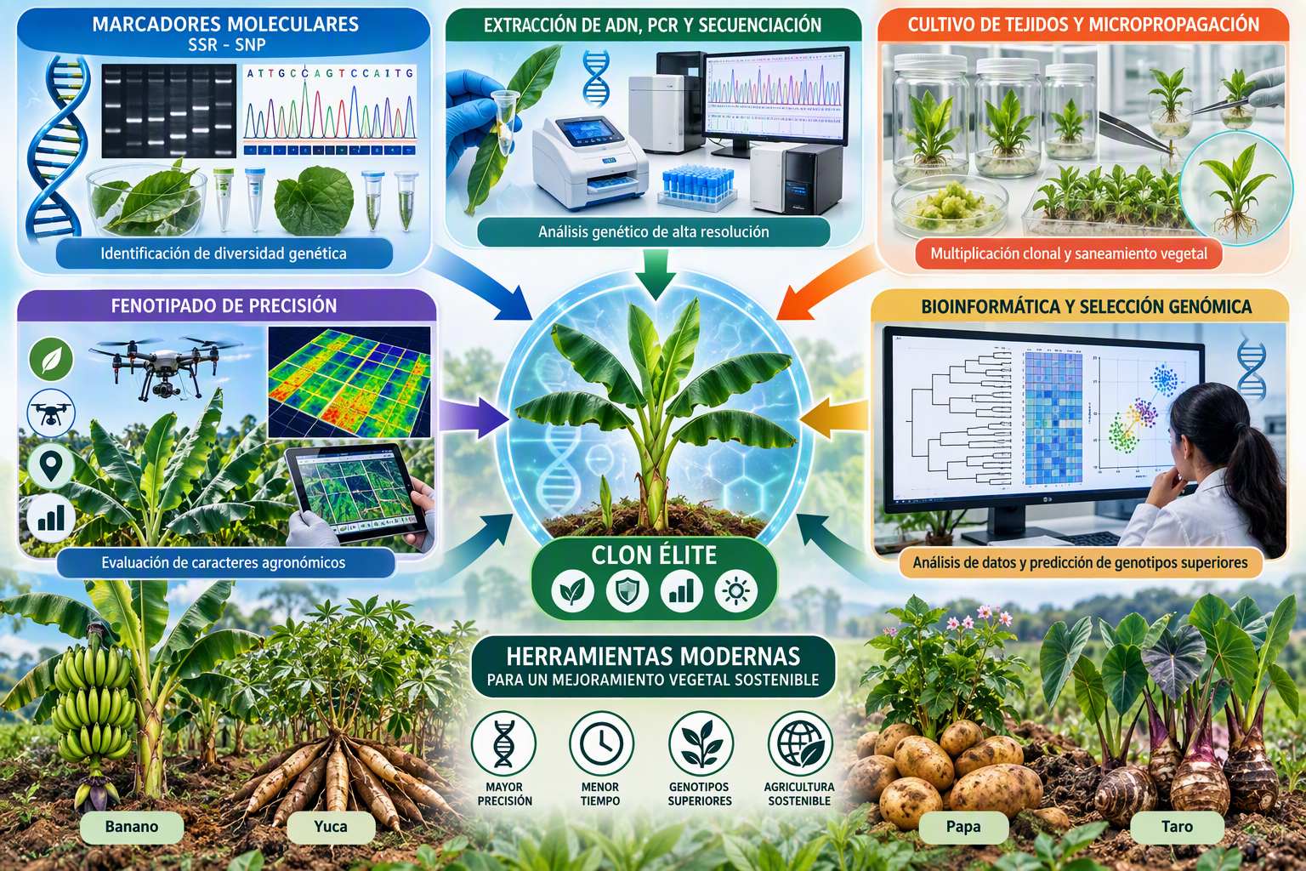

Slide 12
10: conclusiones
Educational plant breeding infographic summarizing asexual crop improvement. Central elite clone connected through arrows to genetic variability, clonal selection, molecular markers, tissue culture, genomic analysis and large-scale propagation. Banana, cassava, potato and taro displayed around the diagram. Scientific and professional university textbook illustration, realistic genetics and biotechnology elements, high resolution, clean background, no text, no empty space.

Slide 13
